Slide 1

Devices for burning biomass

Slide 2
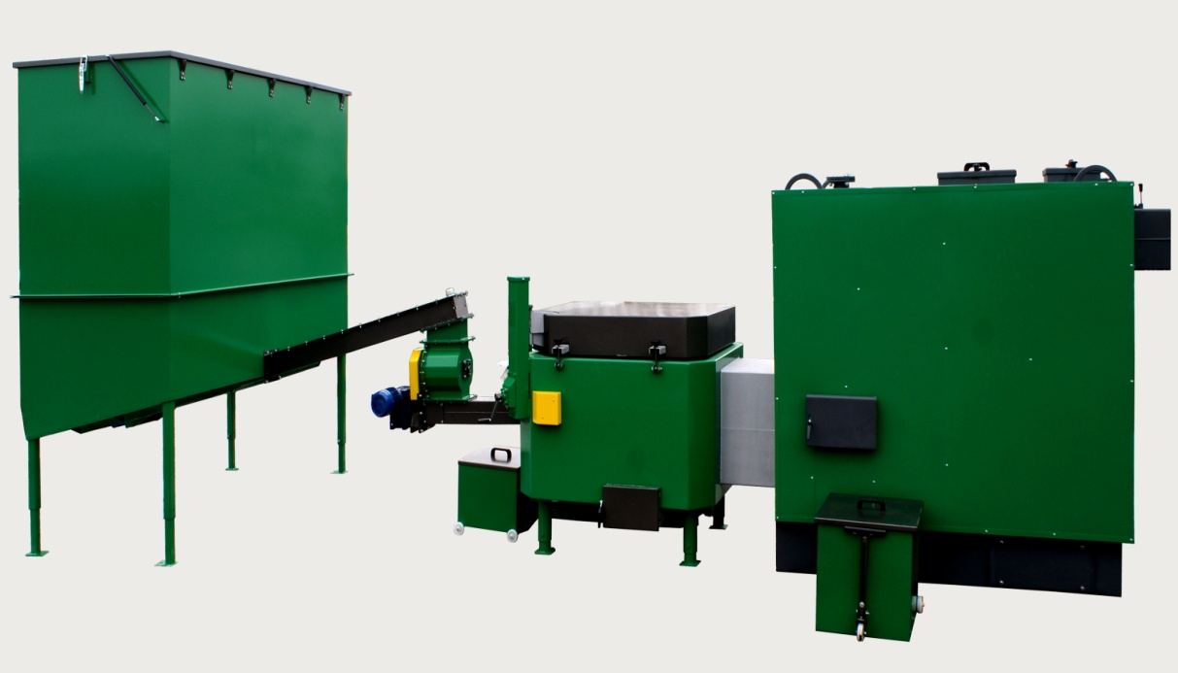
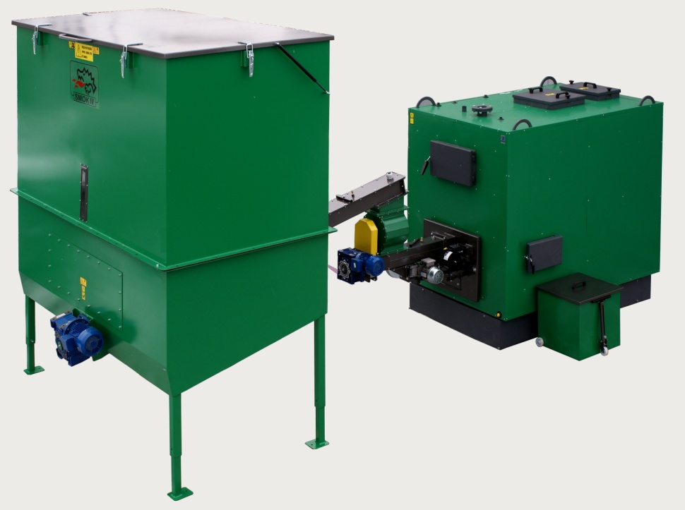

Slide 3
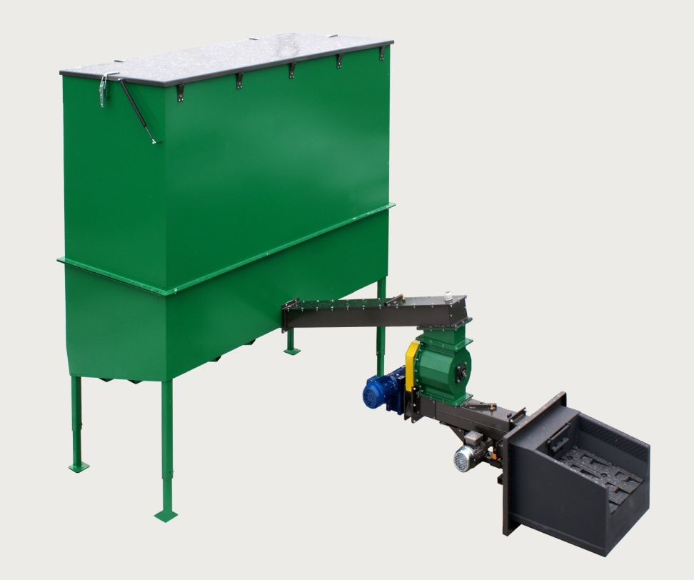
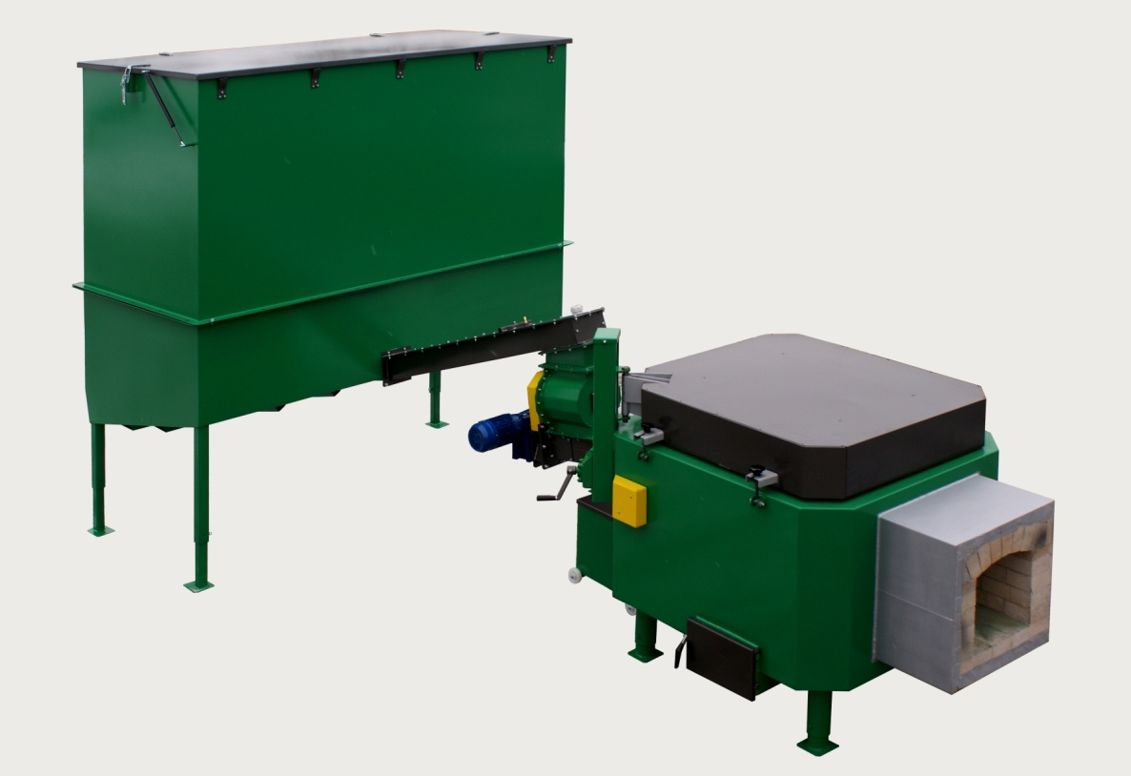

Slide 4
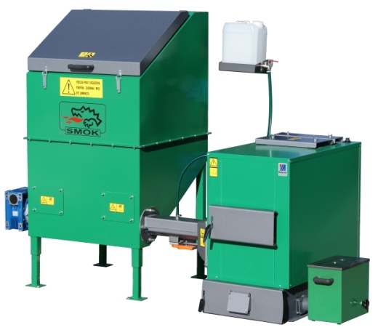
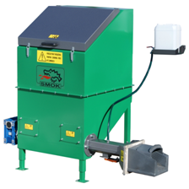
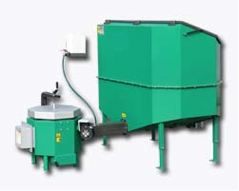
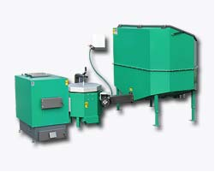
BIOMASS BURNING DEVICES
Cast iron head sets
Cast iron head feeder
Ceramic head sets
Ceramic head feeder

Slide 5
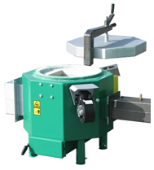
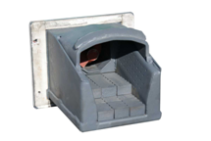
BURNERS’ POWERS
CERAMIC HEAD
Made from high temperaturę resistant materials (approx. 1100C), features a multi point air inlet system and an ash removal system
Cast iron head
Features a movable step grate and a multi point air inlet system
20 KW
30 KW
40 KW
60 KW
120 KW
180 KW
240 KW
FUEL HUMIDITY UP TO 25%
30 KW
50 KW
100 KW
240 KW
FUEL HIMIDITY FROM 25% UP TO 40%

Slide 6
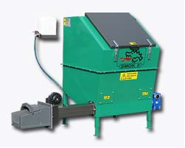
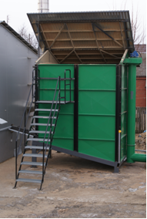
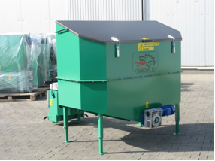
FUEL CONTAINERS
VOLUME
.
0,6 m3
1,0 m3
2,0 m3
4,0 m3
6,0 m3
8,0 m3
10,0m3
27,0 m3
CONTAINERS 0,6 m3 -2m3 – 230V (up to 120kw)
CONTAINERS 4 m3 -27m3 – 400V

Slide 7
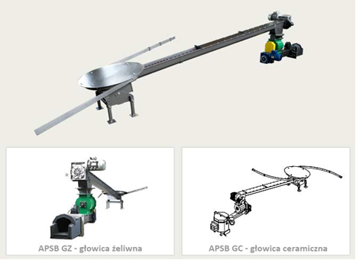
ALTERNATIVE TO CONTAINERS: SPRING FEEDERS

Slide 8
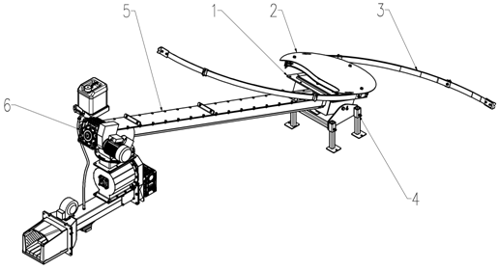
SPRING FEEDERS ELEMENTS:
1 – mounting plate, 2 – shield, 3 – spring raking arms, 4 – base, 5– conveyor/feeder, 6 – motoreducer

Slide 9
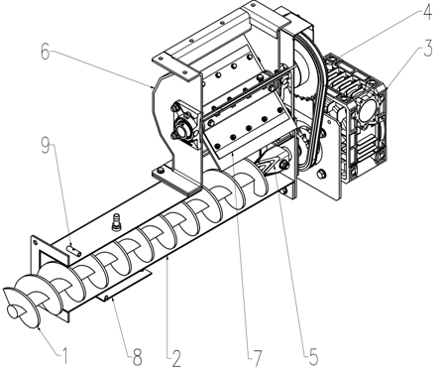
Chamber conveyor (ROTARY FEEDER)
1 – lower feeder screw, 2 – lower feeder cover, 3 – driving motoreducer, 4 – chain gear, 5 – clutch, 6 – dosing feeder cover, 7 – dosing feeder rotor, 8 – mounting base – Belimo system (moving grates), 9 – feeder temperature sensor duct

Slide 10
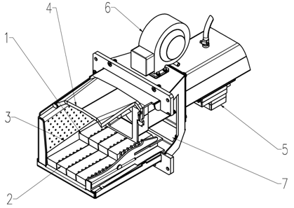
CAST IRON BURNER
1 – movable grate, 2 – fixed grate, 3 – head fireplace, 4 – burner cover, 5 – grates driving motor, 6 – fan, 7 – burner cleaning opening

Slide 11
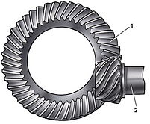
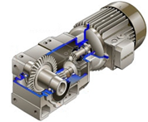
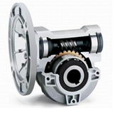
Motoreducers
240V | 0,6 – 2М3 CONTAINERS | SPIRAL BEVEL GEAR(1/60, 0,75 kW 900 rpm)
380V | 0,6 – 2М3 CONTAINERS | Cylindrical bevel gear 1/125, 0,75 kW 1400 rpm
380V | 4,6,8,10М3 CONTAINERS | UPPER FEEDER – CYLINDRICAL GEAR 1/100, 1,5 KW 1400 rpm LOWER FEEDER – CYLINDRICAL GEAR 1/100, 0,75 KW 1400 rpm
380V | SPRING ARMS | UPPER FEEDER – CYLINDRICAL BEVEL GEAR 1/120, 1,1 kW 1400 rpm LOWER FEEDER – CYLINDRICAL GEAR 1/100, 0,75 KW 1400 rpm

Slide 12



TYPES OF FUEL
The „SMOK” is intended for burning various types of biomass in the form of sawdust, chips, shavings, briquette, pellets or grains and fruit pits
Р45 chips
SAWDUST
BARK
BRIQUETTE / AGRO-BRIQUETTE
PELLETS/ AGRO – PELLETS
Processed and unprocessed fuels

Slide 13
QUALITY OF BIOMASS. NORMS, PROPERTIES, REQUIREMENTS
EUROPEAN NORM
CEN/TS 14961
COUNTRY SPECIFIC NORM
Fraction size (P16/P45/P63/P1000)
Moisture content (М20/M30/M40/M55/M65)
ash(A0.7/A1.5/A3.0/A6.0/A10.0)
Heating value MJ/kg
density, kg/m3
Сhlorine contant ,%
Nitrogen contant,%
ONORM M 7135 AUSTRIA
SS 187120 SWEDEN
DIN 51731 GERMANY
CTI – R 04/5 ITALY
BRITISH BioGen ENGLAND

Slide 14
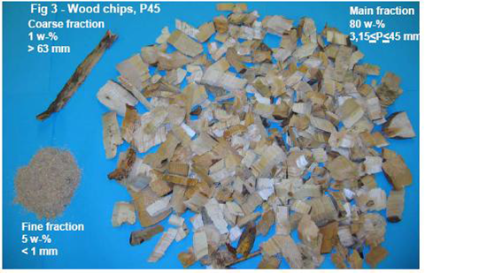
WOOD CHIPSACCORDING TO NORM Р 45
Main fraction˃80%
3.15≤ P ≤ 45 mm
Fine fraction ˂5%-m
˂1mm
Coarse fraction,
Max. Particle length˂1 m - %˃63 mm

Slide 15
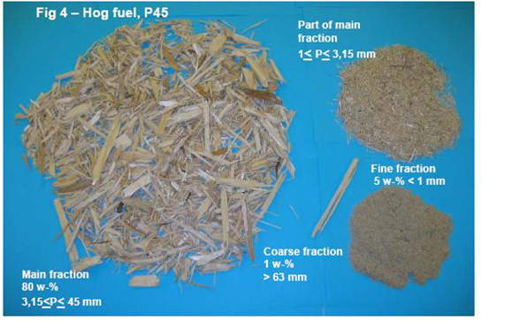
WOOD CHIPS ACCORDING TO NORM Р 45
Main fraction˃80%-m
3.15≤ P ≤ 45 mm
Fine fraction ˂5%-m
1≤P≤3,15mm
Fine fraction 5w-%˂1 mm
Coarse fracation,
Max. Particle length ˂1 m - %˃63 mm

Slide 16
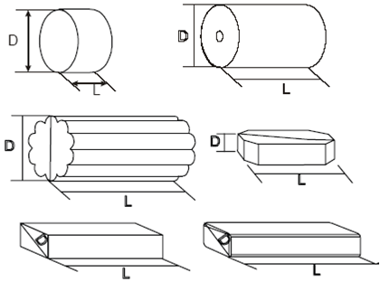
Wood briquette
Briquet with bulk density up to 450kg/m³
origin– barkless wood, not chemically treated
Moisture content– М10
Particle density– DE1.0 (1.00-1.09 kg/dm3)
Ash content: A 0.7 %
additives ˂2 %
Net heating value E4.7 (E≥4,7kWh/kg = 16,9 MJ/kg)

Slide 17
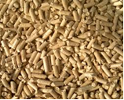
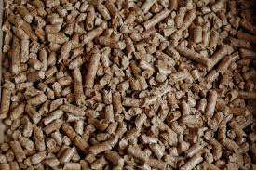
PELLET
origin– barkless wood, not chemically treated
Moisture content– М10
Mechanical durability DU97,5 (97.5 w-% of granulate in 100 g should not be crushed in testing)
% dust content
Ash content A 0.7 %
Sulphur content
additives ˂2 %
Net heating value E4.7 (E≥4,7kWh/kg = 16,9 MJ/kg)

Slide 18
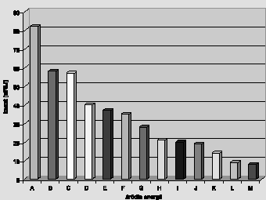
Heating price comparison
 | electricity Two-rate electricity (50/50%) Liquid petroleum gas mazut Electricity, 2nd rate District heating Natural gas Coke Coal Heat pump E=4 (daily rate) Heat pump E=4 two-rate (50/50%) Heat pump E=4 (2nd rate). Biomass.

Slide 19
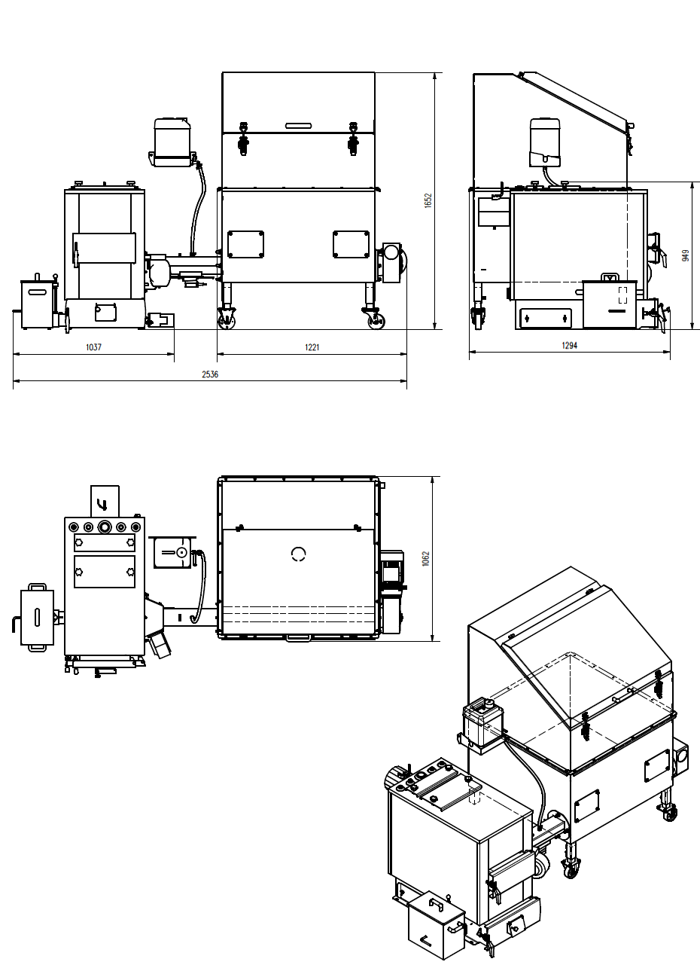
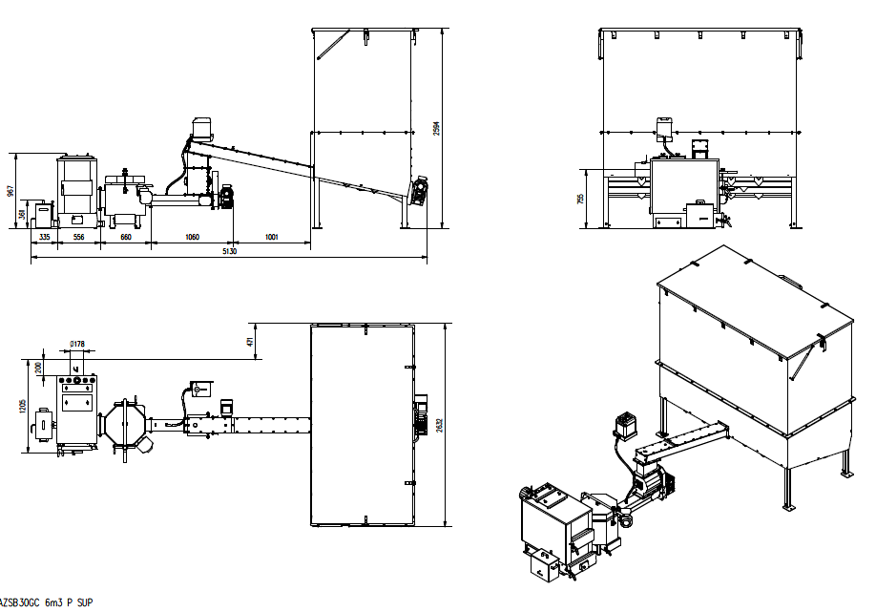
SMOK schematics
AZSB GZ 30R 1M3 Z SUP (230V)
AZSB 30 GC 6M3 P SUP

Slide 20
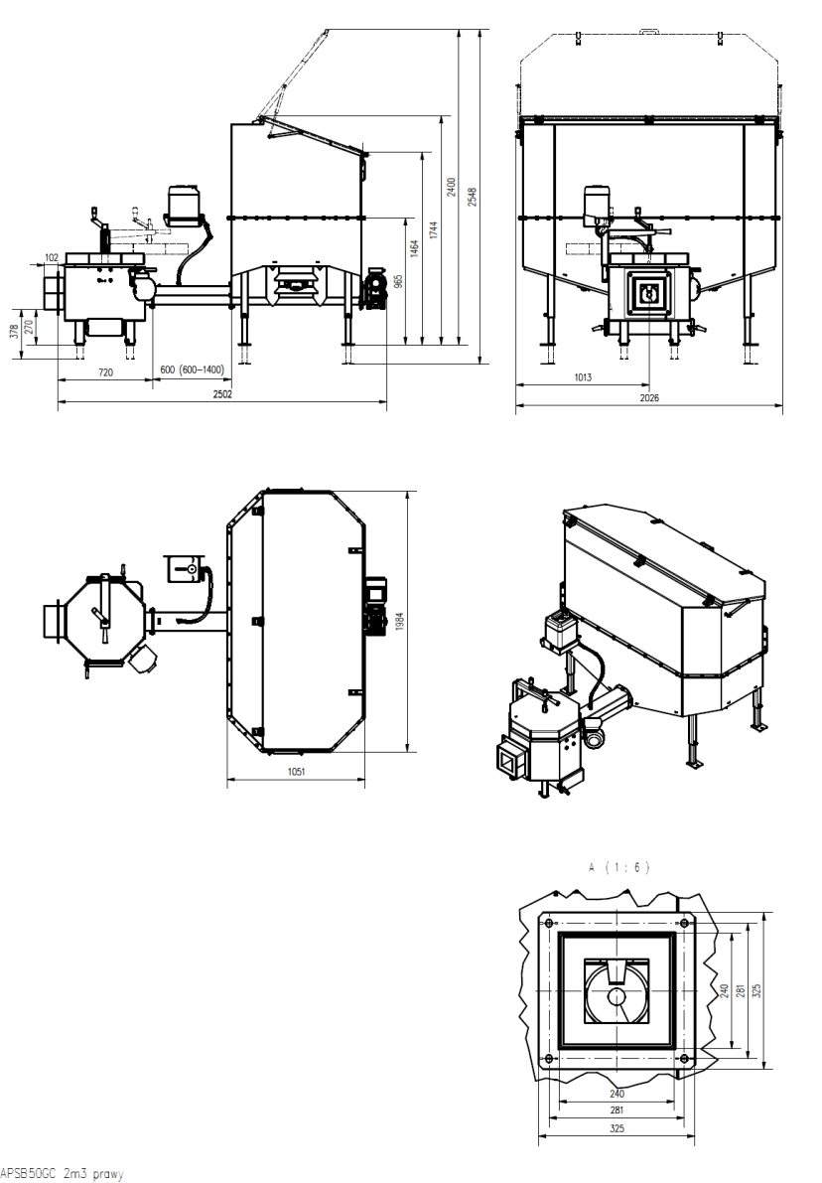
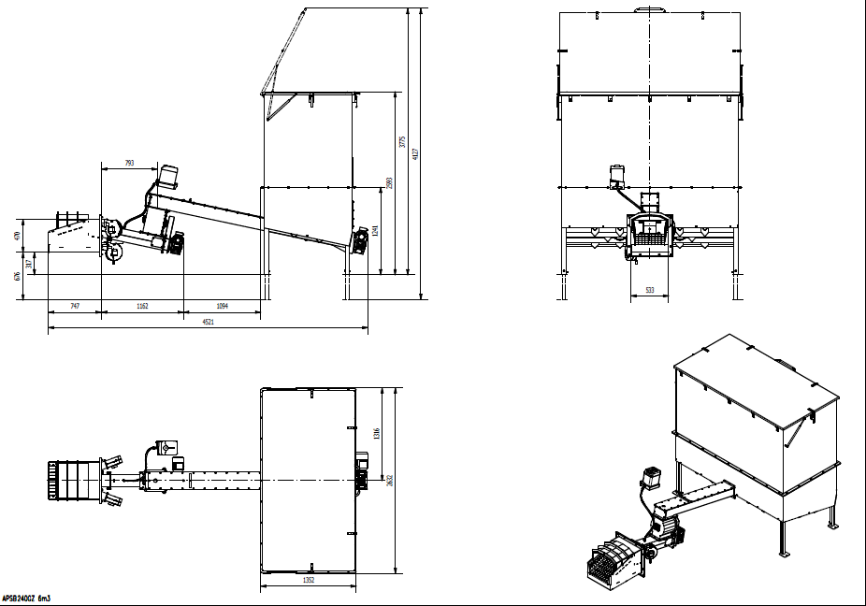
SMOK Schematics
APSB 50 GC 2M3 P
APSB 240 GZ 6M3

Slide 21
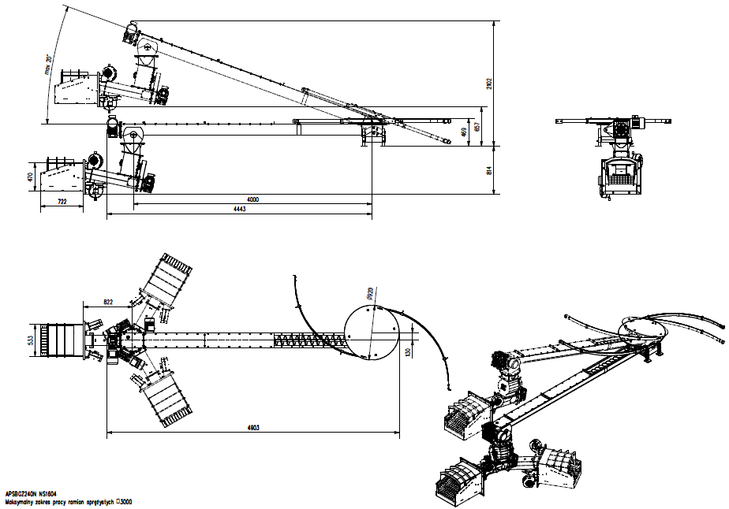
SMOK schematics, configuration
APSB GZ 240N NS1604

Slide 22
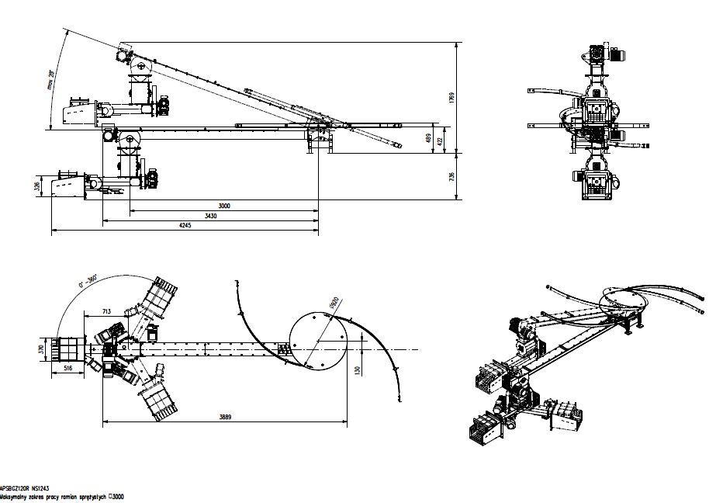
APSBGZ120R NS1243

Slide 23
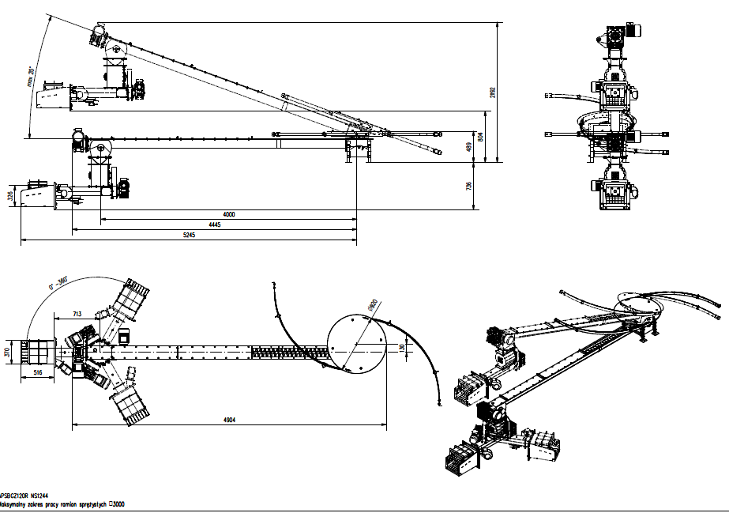
APSBGZ120R NS1244

Slide 24
SMOK – IRELAND AZSB GZ 240 KW NS

Slide 25
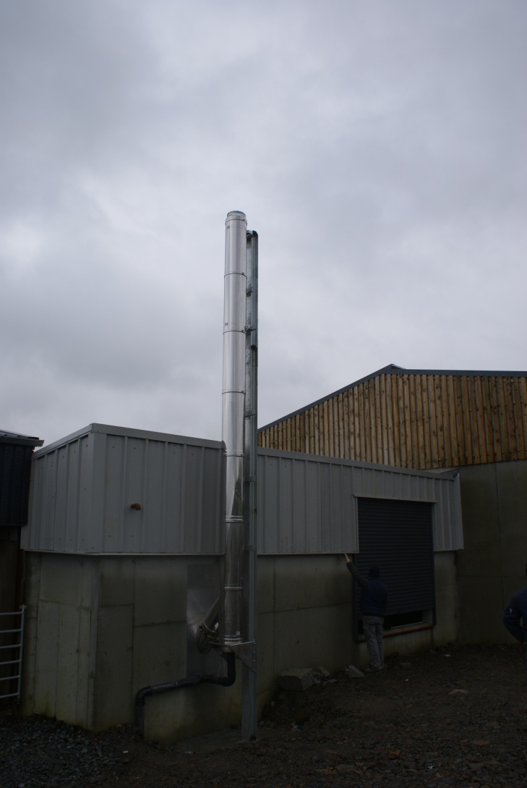
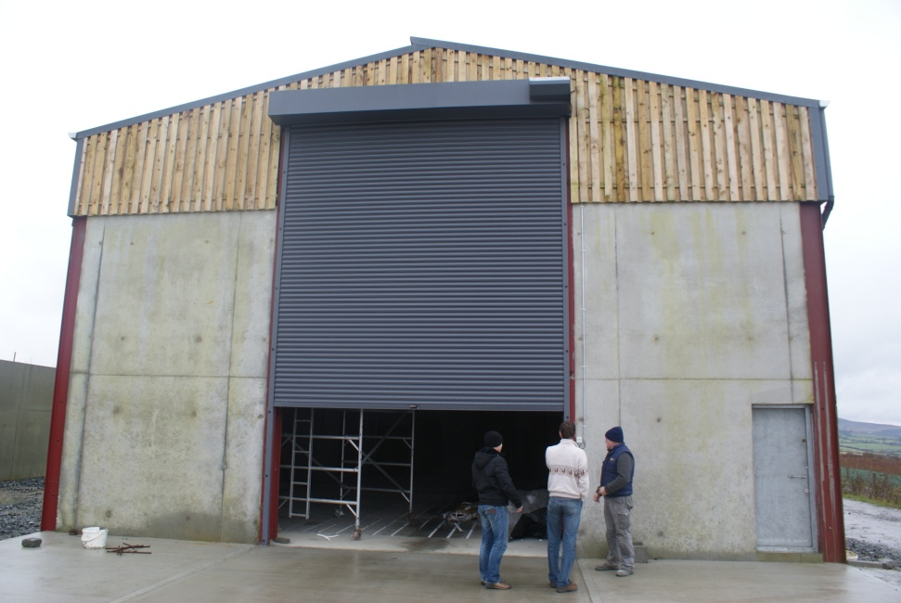

Slide 26
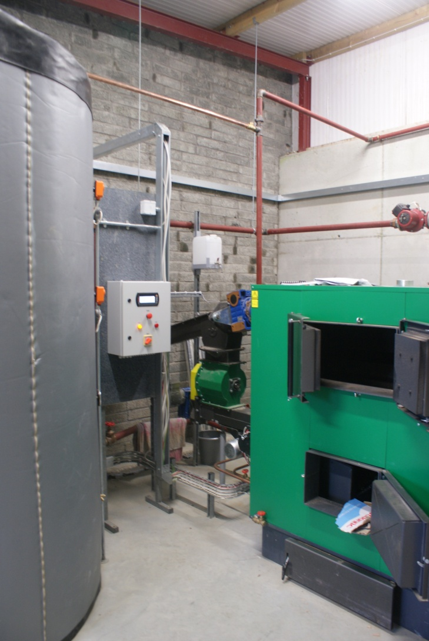
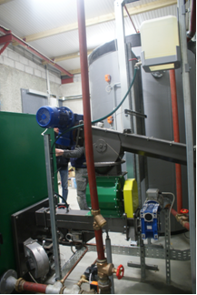

Slide 27
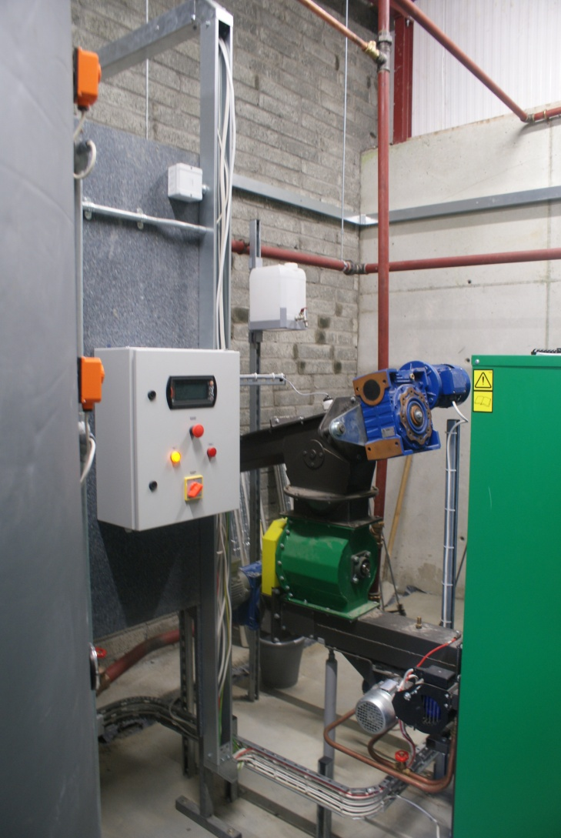
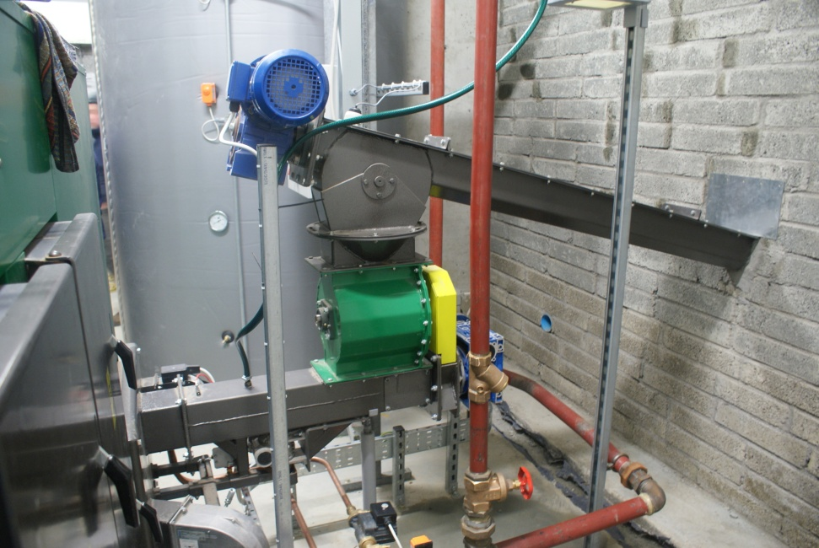

Slide 28
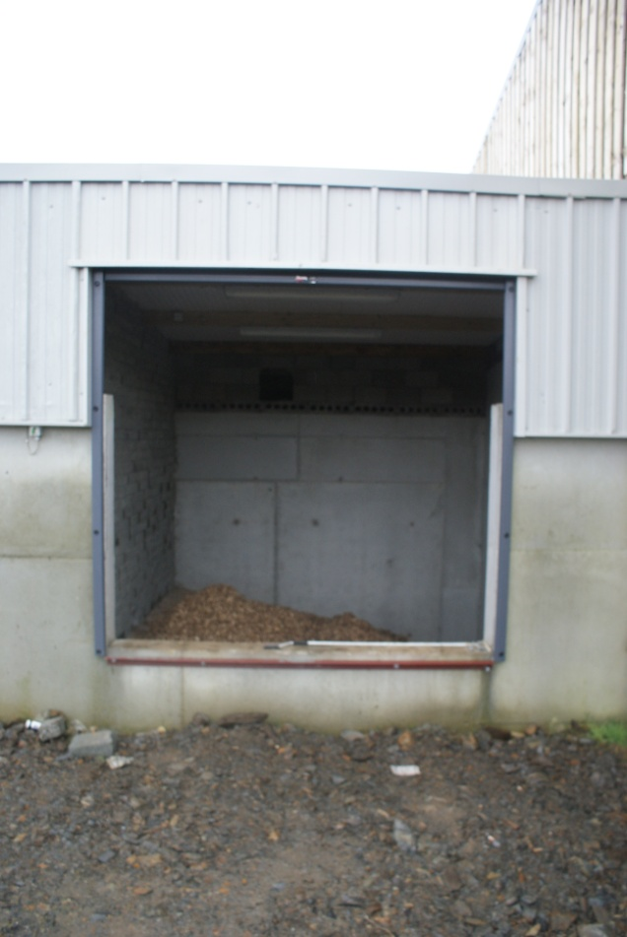
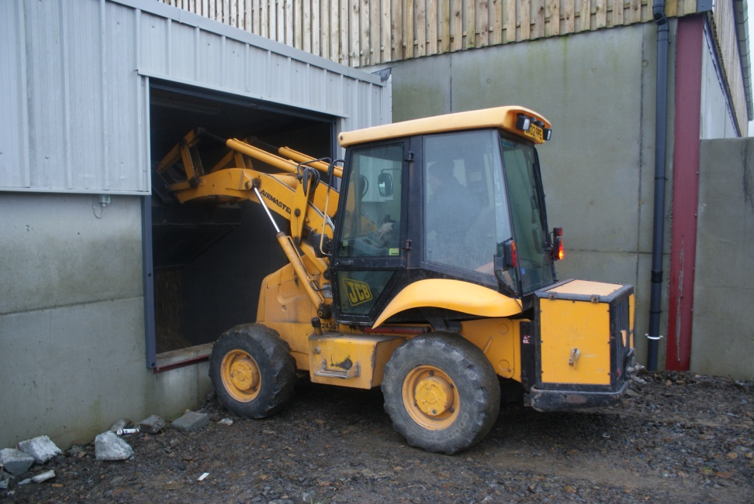

Slide 29
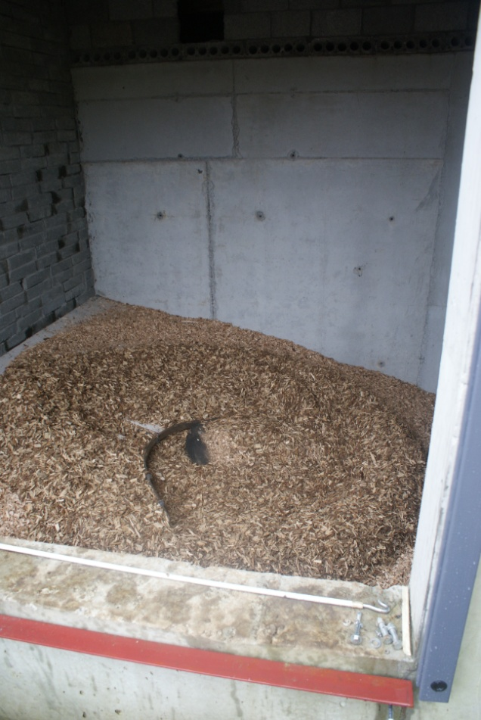
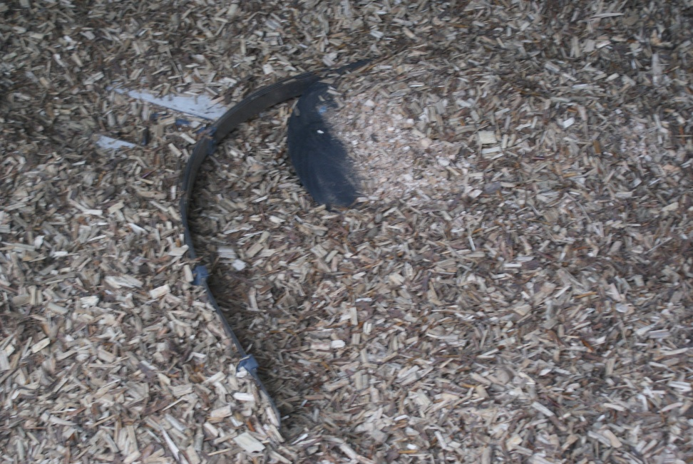

Slide 30
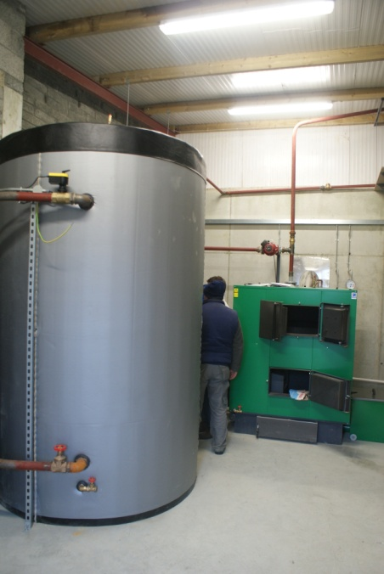
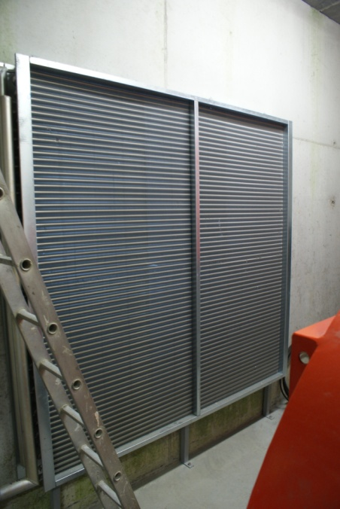
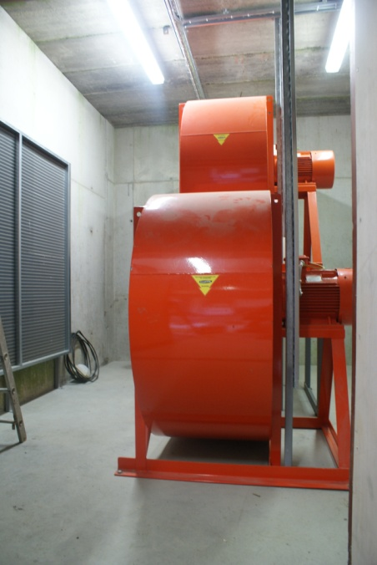
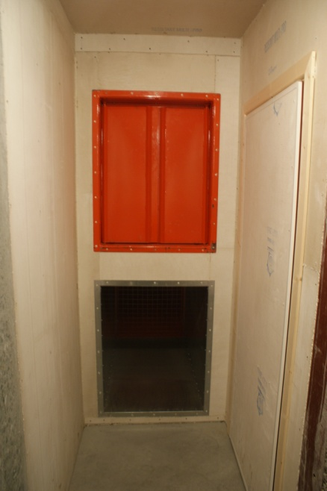

Slide 31
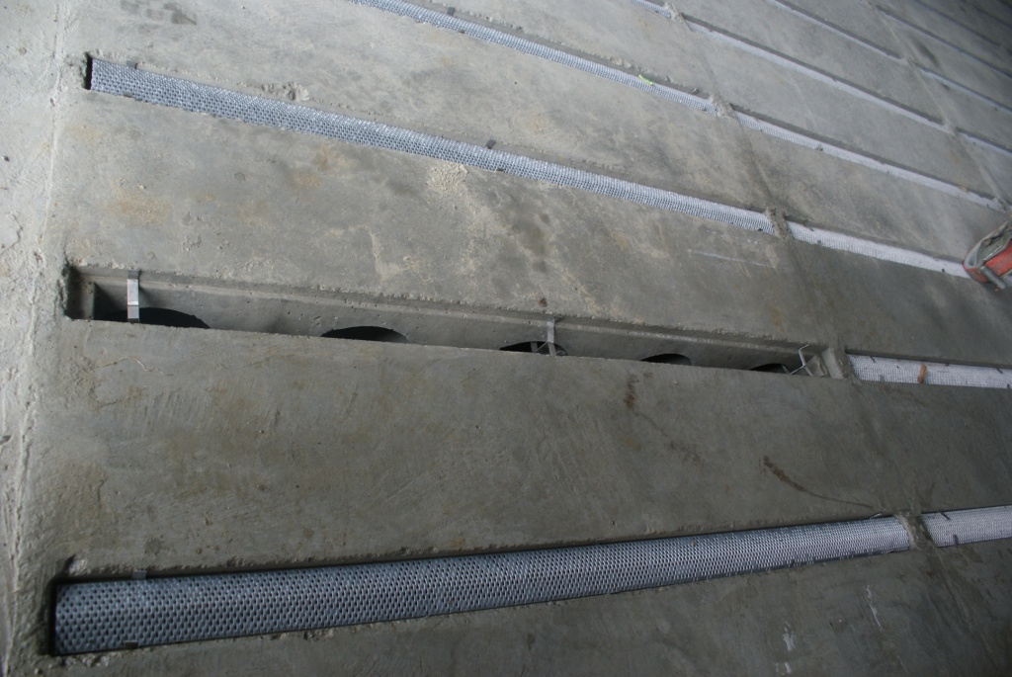
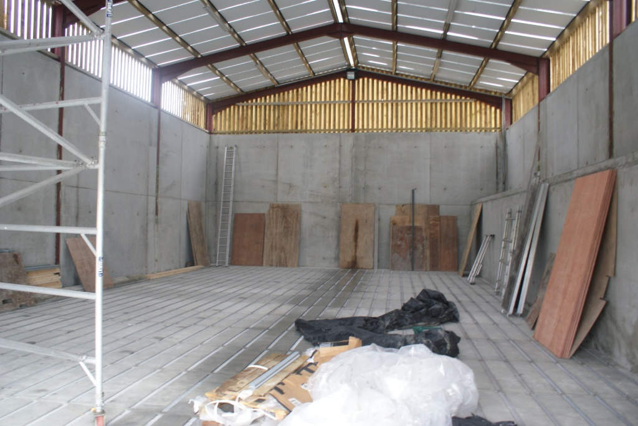

Slide 32
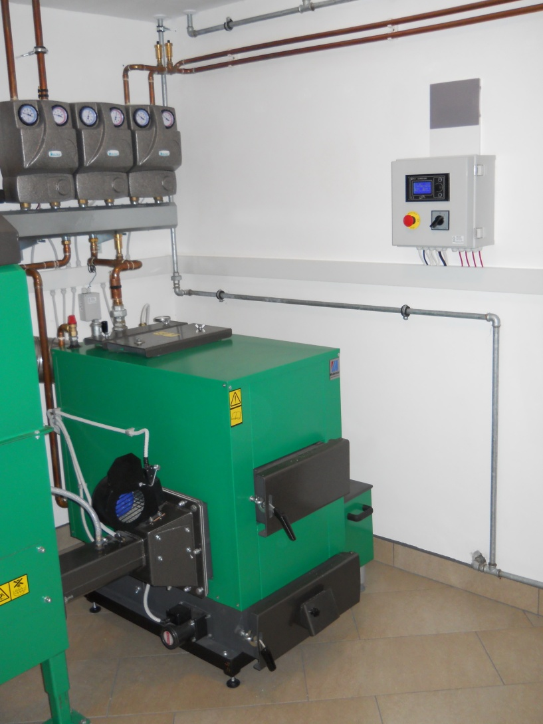

SLOVENIA

Slide 33


POLAND
PL - CHWALISZEWO
23 YEARS OF OPERATION

